Slide 1

WELCOME TO INSTANT DATA CARE
OST to PST Converter

Slide 2
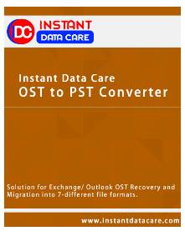
IDC OST to PST Converter Software
IDC OST to PST Converter Software strongly recover all repaired items of Offline OST File like- emails, contacts, calendars, task, notes, inbox items and appointments. OST to PST Recovery Software helps users for recovery emails along with attachments and export OST File to PST Outlook file, MSG, EML, EMLX, MBOX and vCard Format without creating any problem.
IDC OST to PST Conversion Software doesn’t require installation of OST File and safely convert OST file to PST and MSG format. It supports all MS Outlook versions included – 97, 2000, 2002, 2003, 2007, 2010, 2013 and 2016.

Slide 3
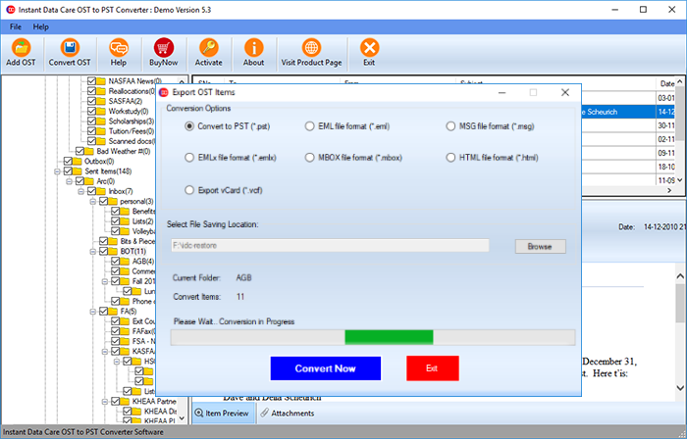
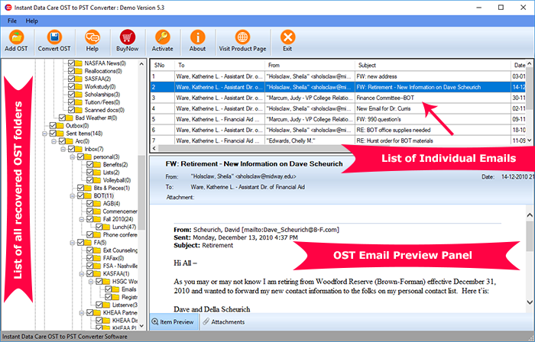
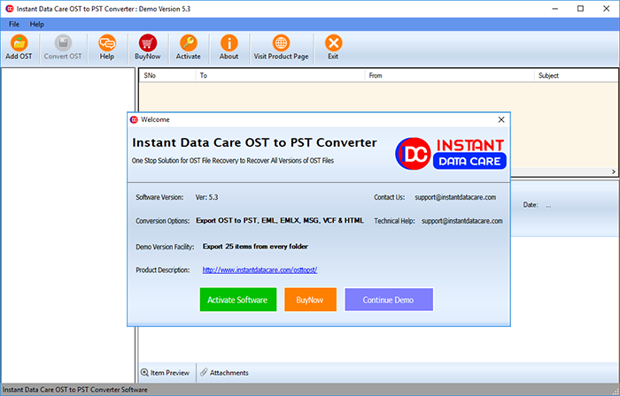
SEE QUICK PREVIEW ON SCREEN

Slide 4
Features of Instant data care OST to PST Converter Software
Recover damaged, corrupted offline OST File
Helps users for repairing damaged OST file and recover OST File emails, contacts, calendars, task, notes and appointments.
Convert offline OST File into PST, MSG, EML, EMLX, MBOX and vCard format.
Convert selective mailbox folders from OST File and shows complete preview of OST file emails, contacts and other items
Supports all MS Outlook versions such as- 97, 2000, 2002, 2003, 2007, 2010, 2013 and 2016
* Preview complete conversion steps and gives you demo facility by which you can save 25 emails per folders.

Slide 5


